Slide 1
Microsoft Graph Overview
Microsoft Identity Platform
Developer Training
1

Slide 2





Microsoft 365
Identity
Productivity
Devices
Security
Microsoft Graph

Slide 3

Microsoft Graph
…is the Microsoft 365 data that describes the patterns of productivity, identity and security in an organization, accessed through a unified API endpoint.

Slide 4
Microsoft Graph powers our products

Slide 5
Find all the events in my Outlook calendar
GET https://graph.microsoft.com/v1.0/me
/events?$select=subject
me
Create a new folder in my OneDrive service
POST https://graph.microsoft.com/v1.0/me
/drive/root/children
me
Get me a list of all the conference rooms in my building
GET https://graph.microsoft.com/beta/me
/findRoomLists
me

Slide 6
Popular data sets
Mail
Conversations
Tasks
Users
Files
Events

Slide 7
Activities
Attachments
Audits
Calendar
Categories
Charts
Classes
Contacts
Conversations
Cross-device experiences
Customer booking
Device configuration
Device management
Domains
Education
Events
Files
Financials
Groups
Identity
Lists
Mail
Messages
Notes
Notifications
Pages
Places
Plans
Reports
Schools
Search
Secure score
Security alerts
Sites
Social
Subscriptions
Tasks
Teams
Threat intelligence
Users
Workbooks
…and many, many more

Slide 8







Cross-platform support
.NET
Tier 1
Objective-C
Tier 2

Slide 9
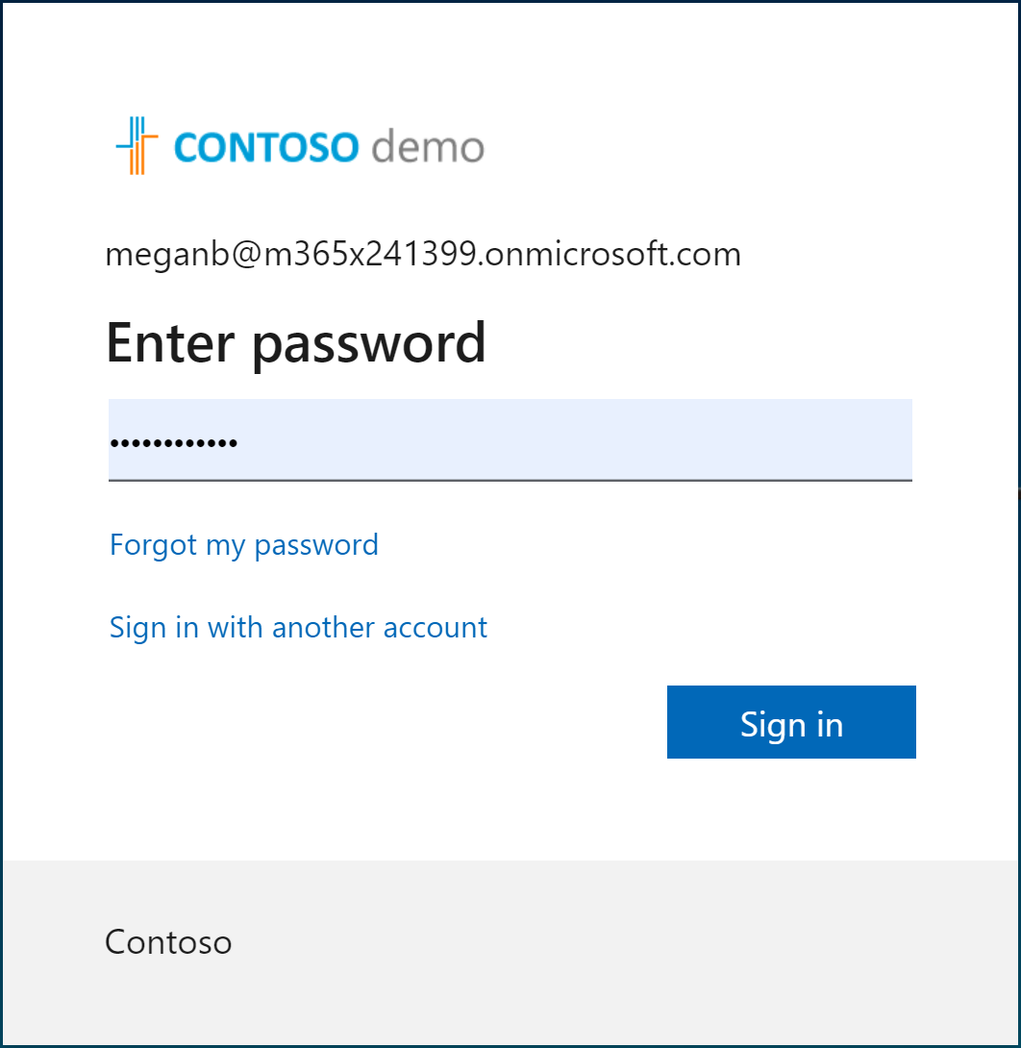
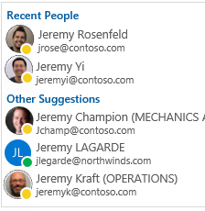
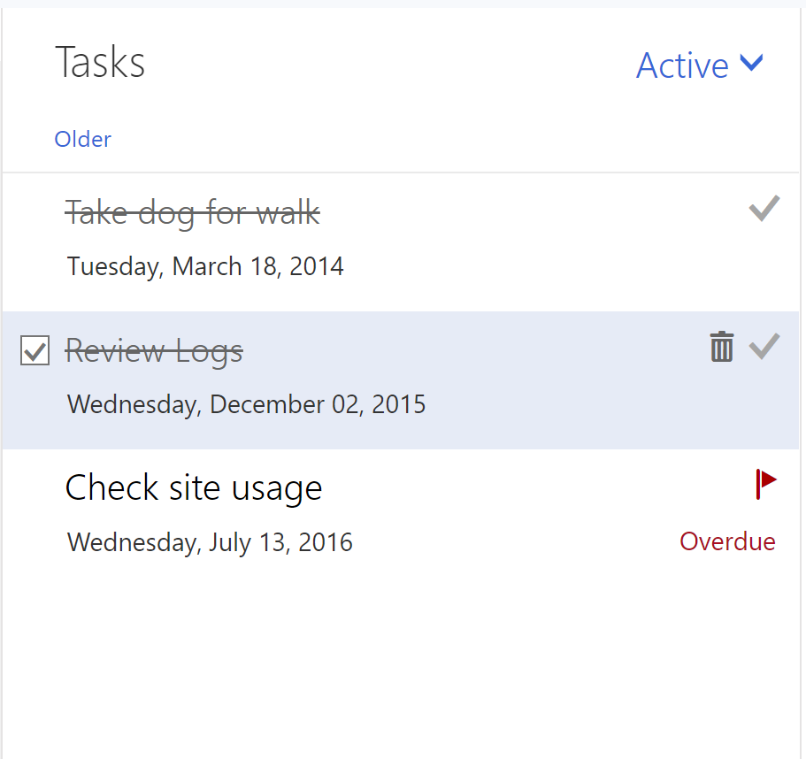
Microsoft Graph Toolkit
A collection of framework-agnostic web components powered by Microsoft Graph
login
people-picker
tasks

Slide 10
Demo: Microsoft Graph Toolkit & Graph Explorer

Slide 11

5 tips and tricks to become a Graph coder
Know the 7 basic operations
Learn the 7 basic query parameters
Watch for server-side pagination
Investigate other query patterns (webhook+delta)
Used least privileged permissions

Slide 12
TIP 1 | Know the 7 basic operations
Intent | HTTP METHOD | Description | Example
List | GET | List collection | GET /users
Get | GET | Get member of the collection | GET /users/{id}
Create | POST/PUT | Create new item in the collection | POST /users/ PUT /me/activities/{id}
Update | PATCH/PUT | Update item | PATCH /users/{id} PUT /me/activities/{id}
Delete | DELETE | Delete item | DELETE /users/{id}
Invoke | POST | Invoke operations | POST /domains/{id}/verify
Batch | POST | Execute multiple requests | POST /$batch

Slide 13
POST/PATCH/PUT | no response required
If your code doesn’t need to get a response, then opt out
Don’t send unnecessary data over the wire
Tip
Use HTTP
Prefer return=minimal request header
Some services always return 204 No content for PATCH and PUT

Slide 14
TIP 2 | Learn the 7 basic query parameters
Value | Description | Example
$filter | Filters results (rows) | /users?$filter=startsWith(givenName,’J’)
$select | Filters properties (columns) | /users?$select=givenName,surname
$orderBy | Orders results | /users?$orderBy=displayName desc
$top | Sets the page size of results | /users?$top=10
$expand | Retrieves related resources | /groups?$expand=members
$count | Retrieves the total count of matching resources | /me/messages?$top=2&count=true
$search | Returns results based on search criteria. Currently supported on messages and person collections | /me/messages?$search=pizza

Slide 15
Querying data | Use projections
Choose the properties your app really needs and no more
Don’t send unnecessary data over the wire
Tip
Use $select
GET https://graph.microsoft.com/v1.0/users?
$select=givenName,mail

Slide 16
Querying data | Use filters
Choose the records your app really needs and no more
Don’t send unnecessary data over the wire
Tip
Use $filter
GET https://graph.microsoft.com/v1.0/users?
$filter=department eq ‘Sales’ & $select=givenName,mail

Slide 17
TIP 3 | Watch for server-side pagination
Graph uses server-side page size limits
When querying collections, Graph may return the results in many pages
Always expect an @odata.nextLink property in the response
Contains the URL to the next page

Slide 18
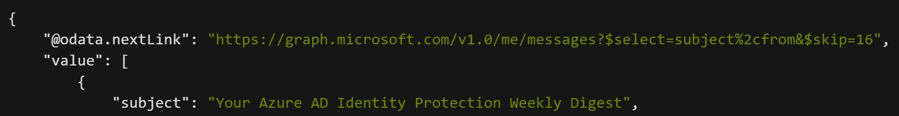
Request
Response
1.
Always handle the possibility that the responses are paged in nature
2.
Follow the @odata.nextLink to obtain the next page of results
3.
Final page will not contain an @odata.nextLink property
4.
Treat the entire URL as an opaque string

Slide 19
TIP 4 | Track changes | Webhooks + Delta query
Scenario
Same scenarios as before, but if you need to optimize further…
Tips
Use webhook notifications as the trigger to make delta query calls
Put notifications in a queue for later processing
Why
Difficult to figure out optimal polling interval

Slide 20
TIP 5 | Used least privileged permissions
Use least privilege! Only request permissions which are absolutely necessary, and only when you need them
Be thoughtful when configuring your app! This will directly affect end user and admin experiences, along with app adoption and security
When building a multi-tenant app, expect customers to have various application and consent controls in different states
Don’t use AppOnly for user interactive scenarios

Slide 21
5 tips and tricks to become a Graph coder
Know the 7 basic operations
Learn the 7 basic query parameters
Watch for server-side pagination
Investigate other query patterns (webhook+delta)
Used least privileged permissions

Slide 22
Continuous Access Evaluation
https://aka.ms/clientCAE

Slide 23
Great Session
https://www.youtube.com/watch?v=Mc1ilblJLJw
https://github.com/piotrci/Microsoft-Graph-Efficient-Operations
Time to get 100,000 users goes from 5 ½ minutes to 18 seconds
UserScenarios: getting all users in a tenant.
GroupScenarios: getting all groups with members.
LicenseManagementScenarios: assigning or removing product licences
DeviceScenarios: creating a report of all devices registered in the tenant.
DeltaQueryScenarios: an optimized way to initialize a delta query for large resource collections (e.g. users or groups)

Slide 24
Migrate from Azure AD Graph
https://docs.microsoft.com/en-us/graph/migrate-azure-ad-graph-planning-checklist
Step 1: Review the differences between the APIs
Step 2: Examine API use
Step 3: Review app details
Step 4: Deploy, test, and extend your app

Slide 25


Get started today
Office 365
Your tailored experiences or customizations
Windows 10
Enterprise Mobility + Security
https://graph.microsoft.com

Slide 26
Microsoft Graph Overview
For Labs and Exercises please refer to the below links -
Build ASP.NET Core MVC apps with Microsoft Graph - Microsoft Graph | Microsoft Docs
Build ASP.NET MVC web applications with the Microsoft Graph .NET SDK - Learn | Microsoft Docs

